Slide 1
Wednesday
1
01.04.2020

Slide 2
1. Read and complete.
Hi, what’s your name ? ………………………………..
John. How old are you? ………………………………..
I’m nine. Are you in 4B? …………………………………
Is Mr Catalin your teacher? ………………………………….
Is Mrs Lucas your teacher? ………………………………….

Slide 3
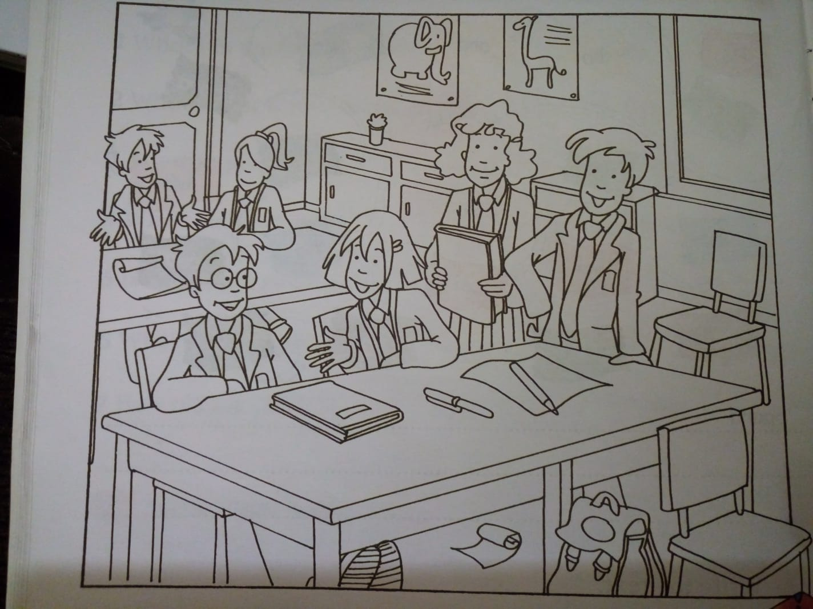
2. Colour. Then write.

Slide 4
The cupboards are …………………………..
The door is ……………………..
The board …… ………………………..
The light ………. …………………………
The floor …………. ………………………..
…………………………………………………….
…………………………………………………….
…………………………………………………….

Slide 5
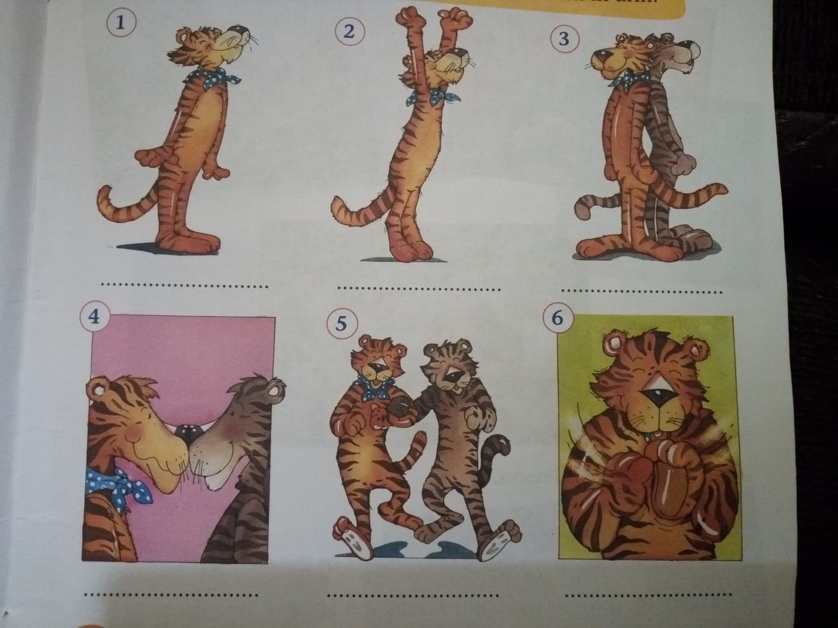
3. Choose and write. Stand up! / Stand nose to nose! / Clap your hands! / Stand back to back! / Stretch! / Stand arm in arm!

